Slide 1

5 Minute Dark Mode Trick
Suh Y Park
ET 710
How to quickly make your website visually accessible using CSS & JS

Slide 2
Download Needed Files
https://github.com/SuhYPark/daynight
index.html
style.css
Two jpg background images (day.jpg & night.jpg)
Place 4 files into a folder

Slide 3
Key points in Index.html
JavaScript located in Head section
function for the day and night modes
<div class=“toggle”> ………</div>
location of content that will be affected by toggle such as text color, size or font styles.

Slide 4
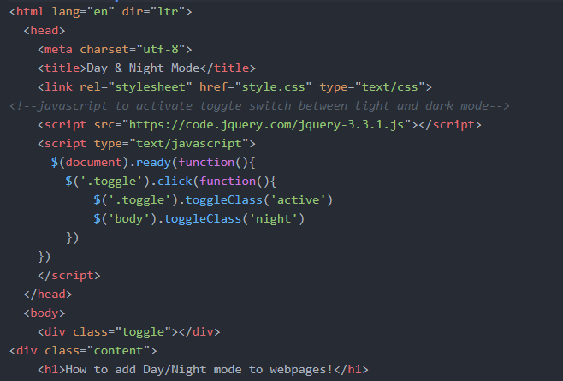

Slide 5
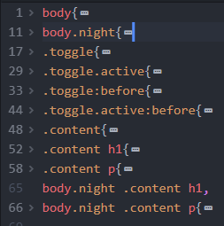
Key points in style.css
Two body css groups.
body{} – for “day” mode
body.night{} – for “night” mode
Two sets of content styles

Slide 6
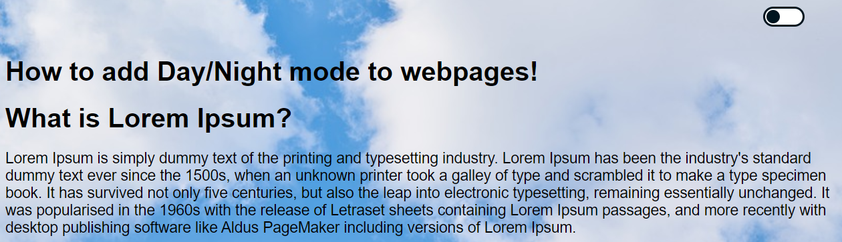
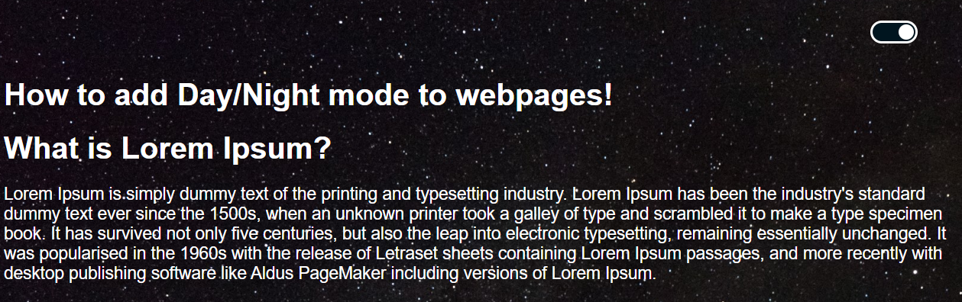

Slide 7
Thank you for your 5 minutes!

